Slide 1

NiChart: https://neuroimagingchart.com
U24 Grant
2nd Scientific Steering Committee Meeting
January 2024

Slide 2
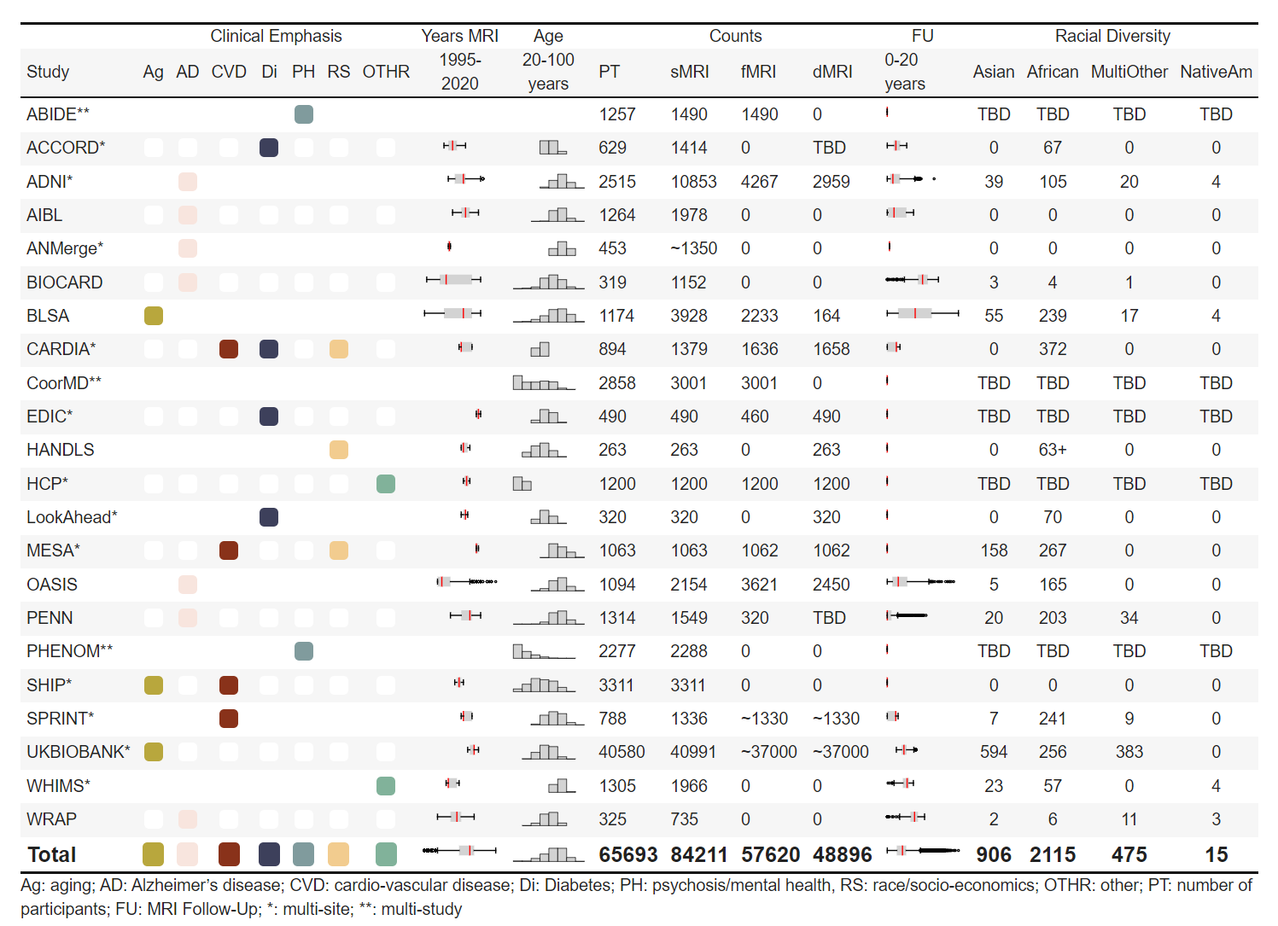
Leadership or Co-leadership in a number of international consortia
+ Public Datasets
Projected total N > 100,000 scans + High diversity of cohorts, diseases, scanners

Slide 3
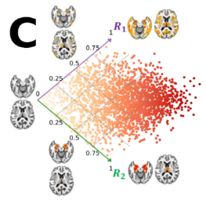

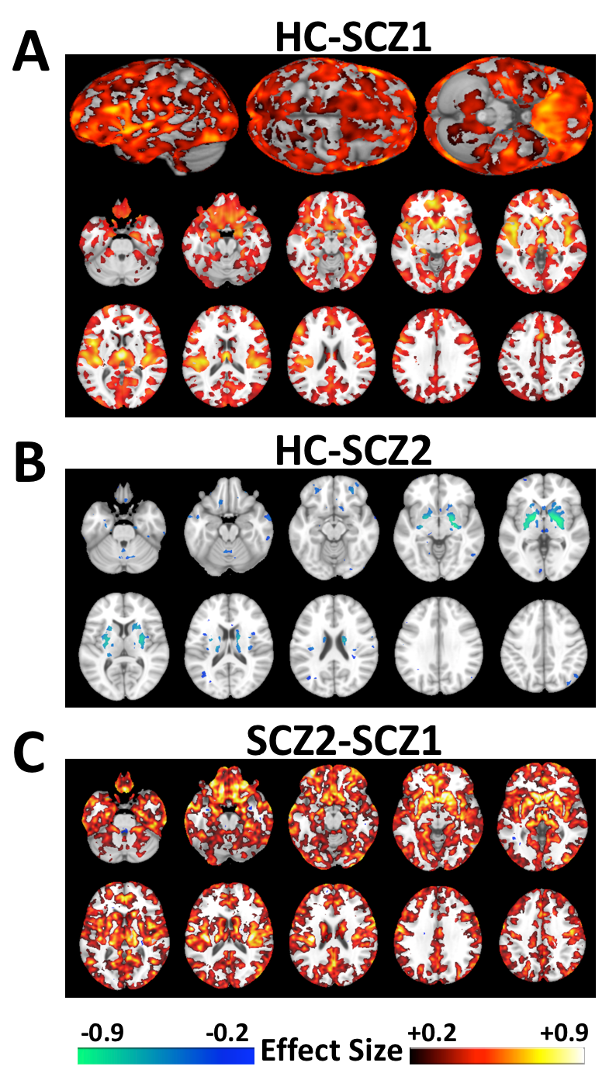
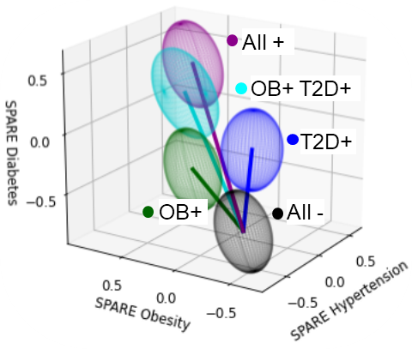
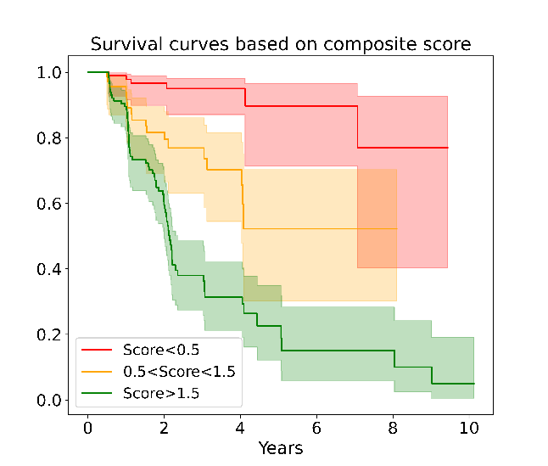
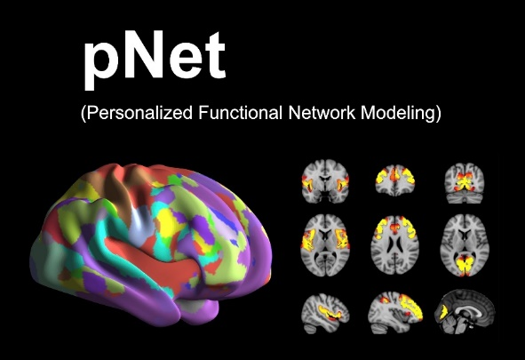
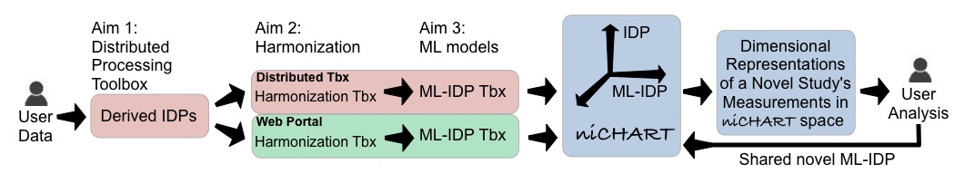
Emphasis on Machine Learning-Derived Imaging Signatures
Imaging Signatures of Cardiometabolic Risk Factors
Schizophrenia Subtypes
JAMA Psychiatry
Molecular Psychiatry
Am. J. Psychiatry
Brain
AD&D
Nature Communications
HBM, Neuroimage
PNAS, …

Slide 4
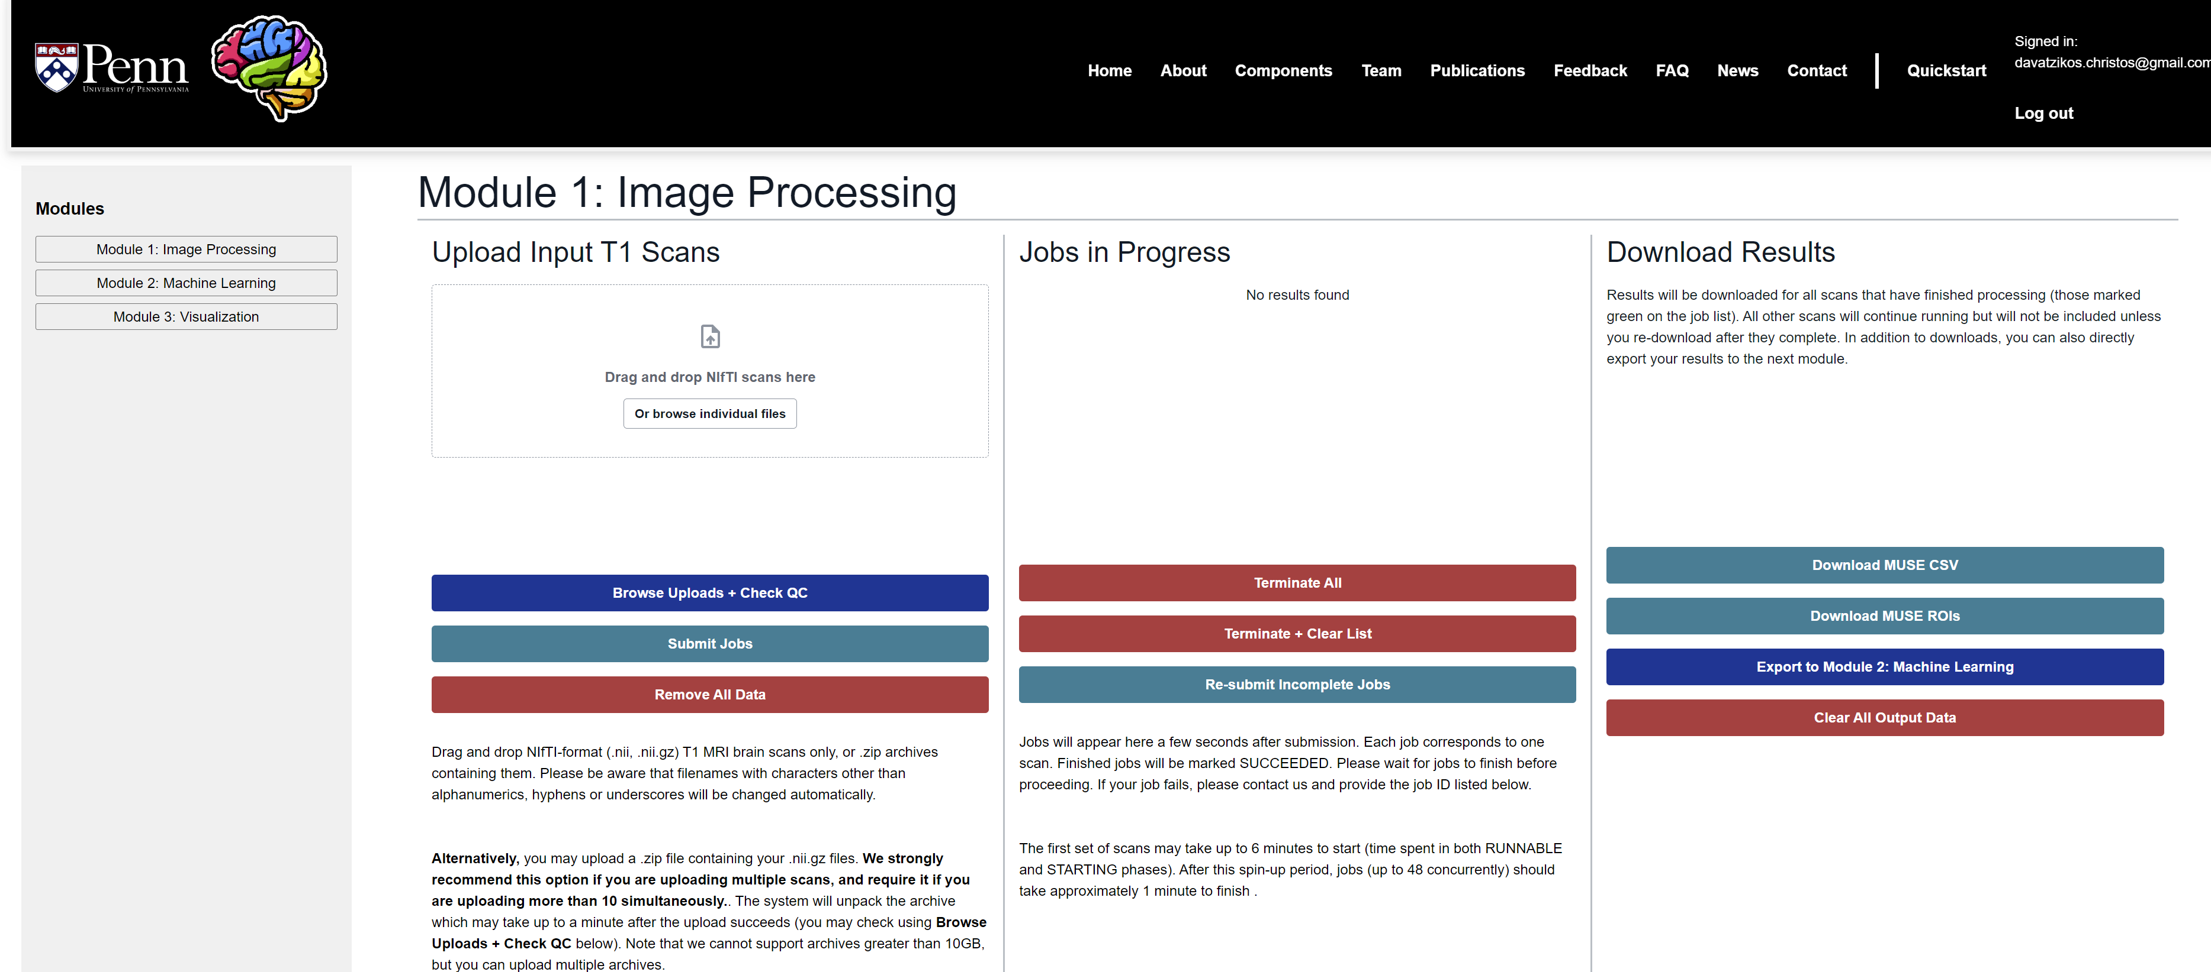
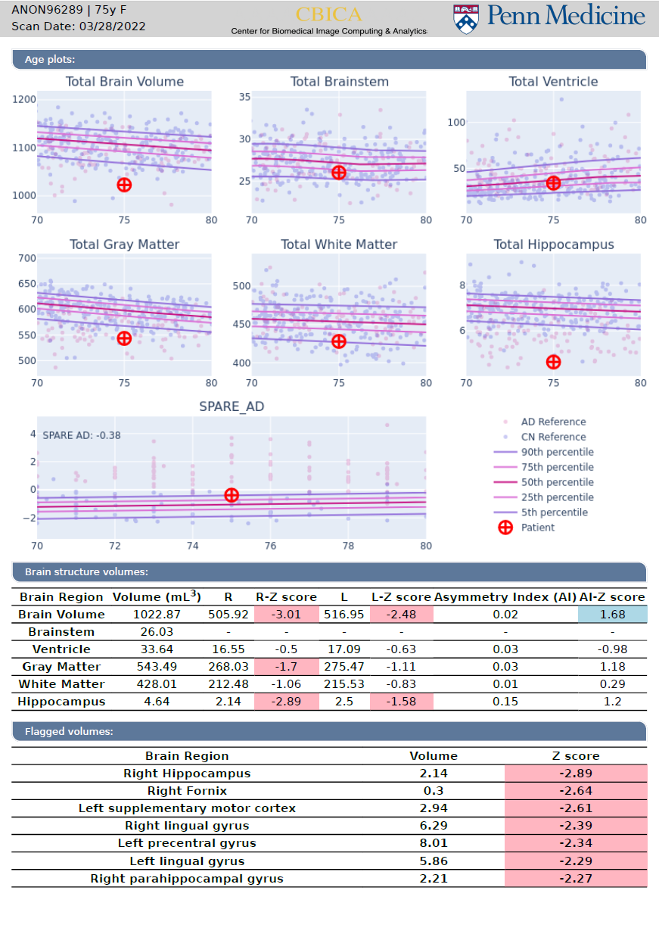
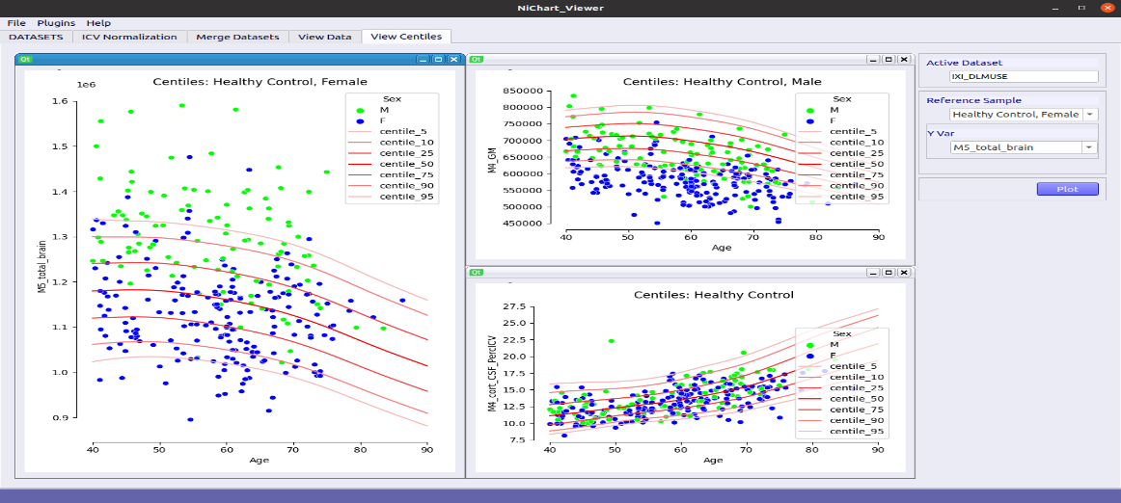
sMRI analysis
NiChart
New in NiChart!!
fMRI and dMRI preprocessing
fMRI and dMRI Network Extraction
Harmonization
Clinical translation

Slide 5
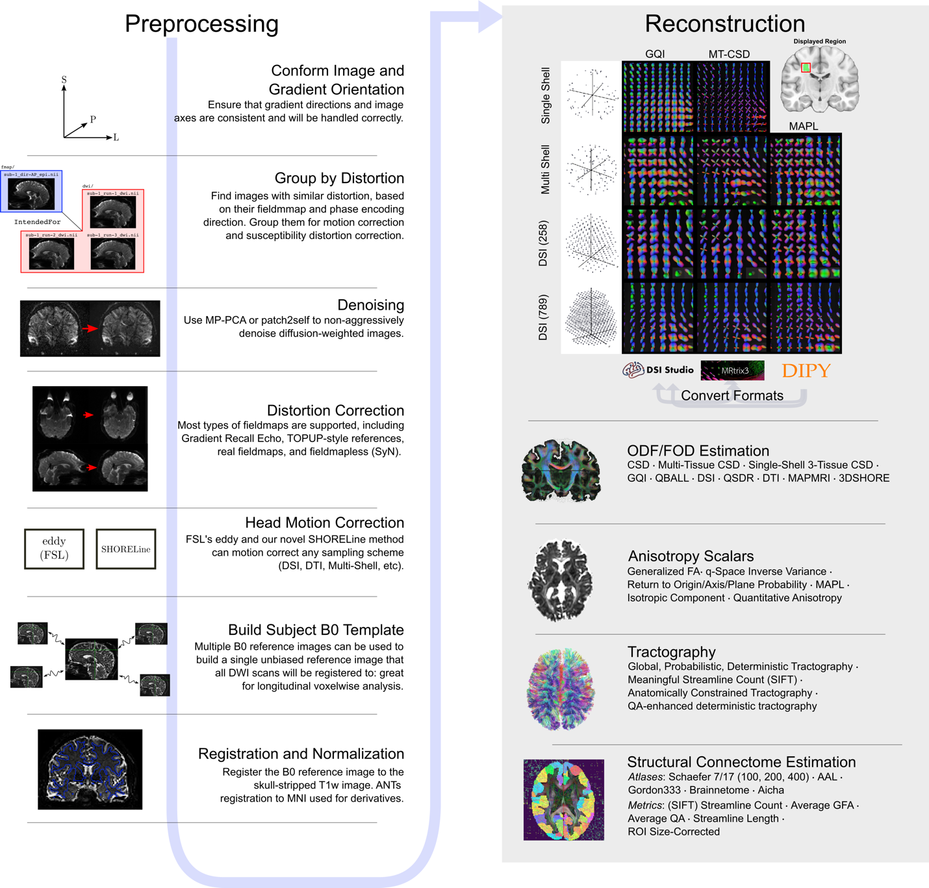
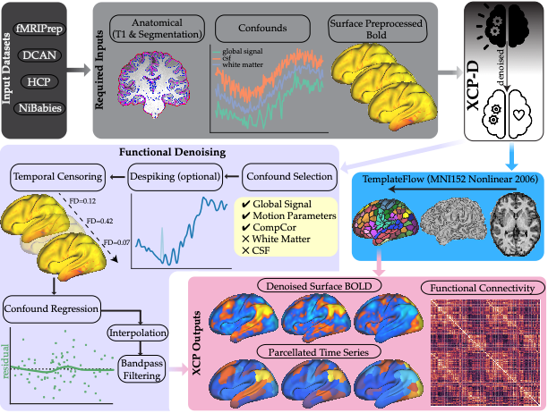
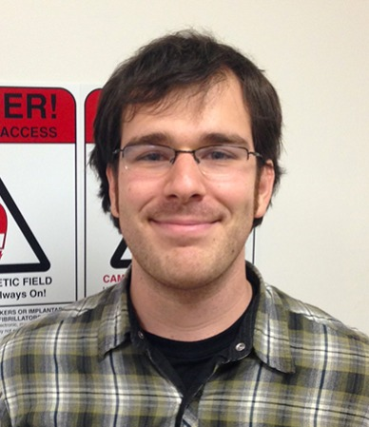
dMRI and fMRI Processing in NiChart
QSIPrep
XCP-D
>10,000 downloads
Matt Cieslak, Ph.D
Senior Scientist
>10,000 downloads
Ciric et al., Nature Protocols 2018
Cieslak et al., Nature Methods 2021

Slide 6
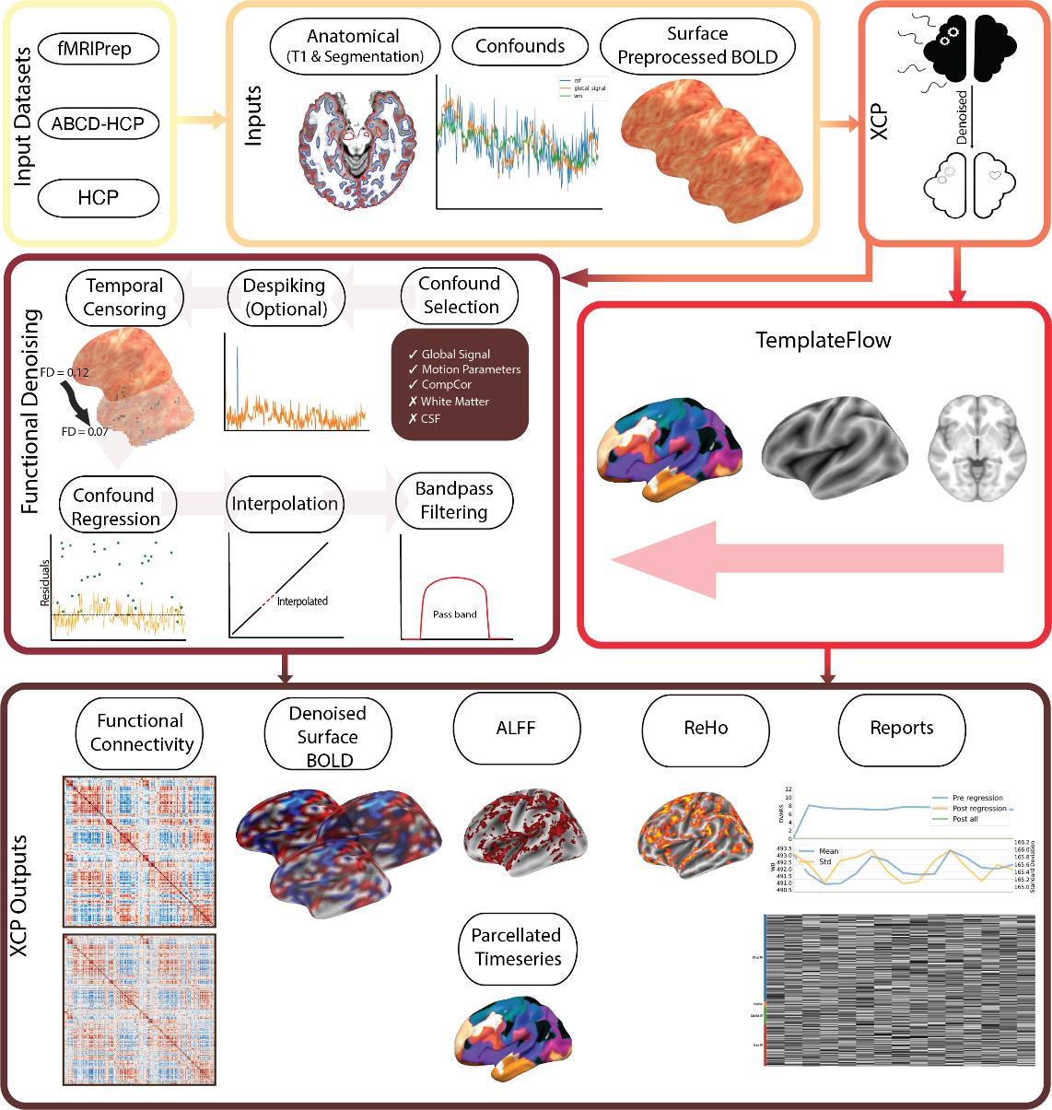
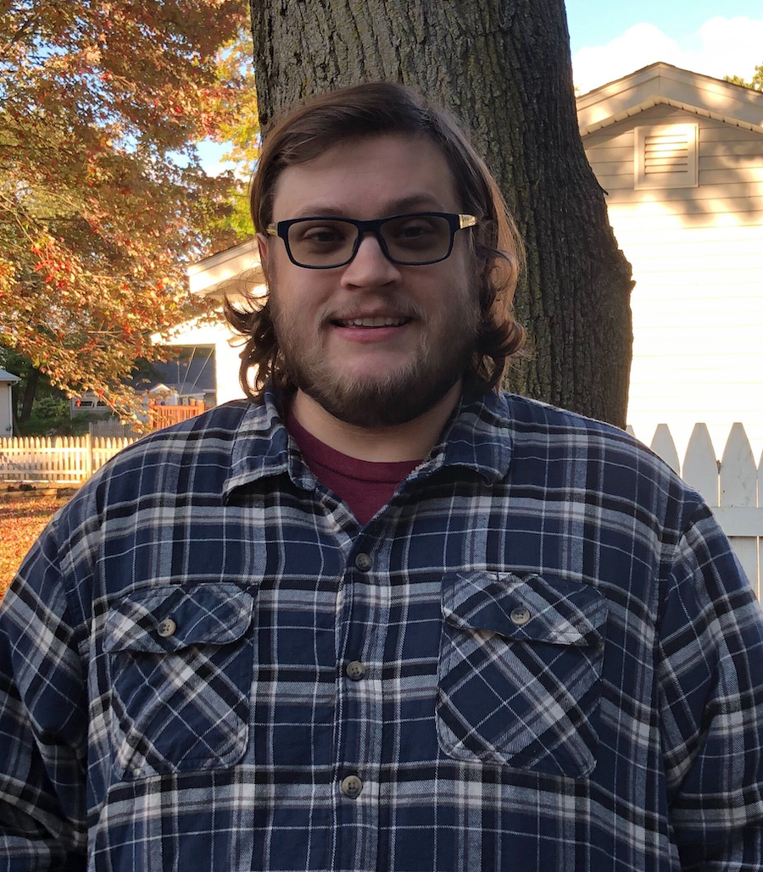
XCP-D for NiChart
Fully-refactored in Nipype
Workflow to ingress minimally preprocessed data from UK Biobank / HCP
Extensive new continuous integration testing on CircleCI
~9,000 runs after NiChart release
Taylor Salo, PhD
Post-doctoral Software Engineer
Mehta & Salo et al., BioRxiv 2023

Slide 7
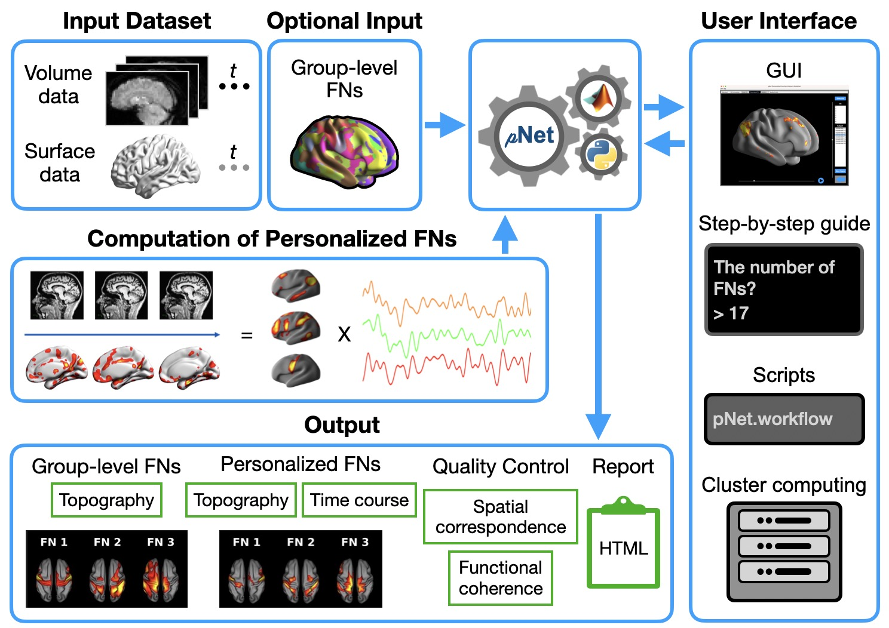
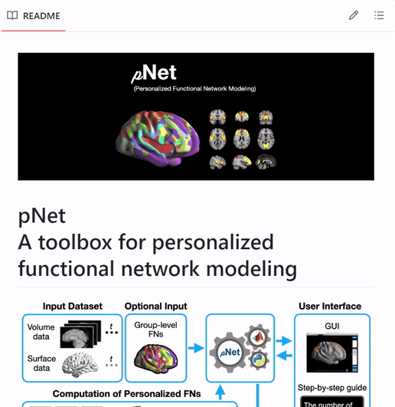
pNet: A toolbox for personalized functional network modeling
New in NiChart!!
Integrated software into a package
Created documentation
Added GUI
Add easy to use QC tool to check derived networks

Slide 8
Specific Aims
Aim 1a, b, c: sMRI, rsfMRI, dMRI preprocessing toolboxes
Aim 2: Harmonization toolbox
Aim 3: Standardize and enrich ML-based imaging signatures and models
Aim 4: Standalone NiChart software, and web-based implementation of preprocessing pipelines
Aim 5: Dissemination, continuous enrichment, distribution. Training and support via online and in-person sessions.

Slide 9
Milestones for Year 1
1.1 Establish steering committee and hold two Scientific Steering Group (SSG) meetings
1.2 Re-allocate and commit effort of existing experienced staff to guarantee that the proposed work in Year 1 will be performed as planned, and identify specific additional recruits that will be necessary for Year 2 onwards.
-- Alex Getka serve as software engineer for the whole project
-- George Aidinis serves as scientific programmer for sMRI work and web portal
-- Matt Cieslak and Taylor Salo serve as scientific programmers for rsfMRI and dMRI pipelines
-- Zheng Ren serves as scientific programmer for harmonization pipelines
-- Yucong Ma and Hongming Li serve as scientific programmers for connectomic network pipelines

Slide 10
Milestones for Year 1
1.3 Establish sustainability activities (required) and establish any outstanding management, project selection, scale-up, data sharing, and outreach plans
-- Methodology evaluation: metrics of accuracy depend on the pipelines; many ML models are evaluated on accuracy, AUC, effect size of ML indices; harmonization is evaluated via simulated domain shifts etc; segmentation is evaluated using DICE scores etc.
-- Estimates of future costs
-- Letters of intent from 11
-- Workplan: The successful set up of the AWS cloud portal has changed our thinking towards web accessible pipelines (deep learning can ease the cost, due to super rapid inference; full automation)
-- Outreach plan: Had demos at RSNA and OHBM. Plan demos at AAIC’24 (multiple), ISBI’24, RSNA’24
-- Governance structure…..

Slide 11
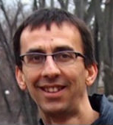
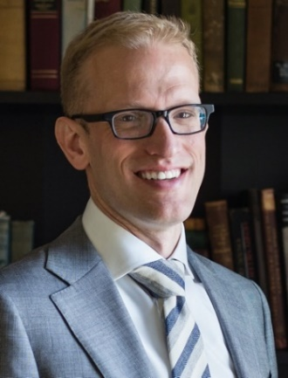
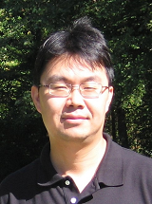
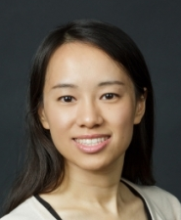
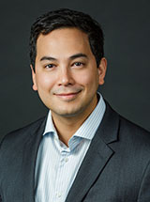
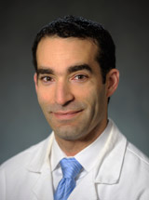
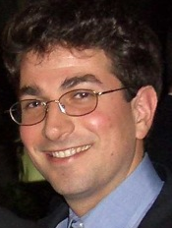

Milestones for Year1…..Governance Structure
Guray Erus: sMRI pipelines, Web portal, NiChart front-end visualization s/w
Ted Satterthwaite: rsfMRI and dMRI pre-processing pipelines
Yong Fan: rsfMRI network analyses
Haochang Shou and Taki Shinohara: Statistical Harmonization
Ilya Nasrallah, Dan Wolf and Ted Satterthwaite: Clinical translation, dissemination and outreach, clinical guidance

Slide 12
Milestones for Year 1
1.4. Conduct optimization and standardization activities
Optimized a deep learning atlas parcelation pipeline, trained on MUSE segmentations along with careful QC and selection; diversity of studies, acquisition protocols, cohorts → FAST parcelation and measurement of ROIs (a few seconds per MRI scan)
Refined, integrated, and documented individual preprocessing pipelines
Developed an AWS cloud based portal (accessed via neuroimaginchart.com/portal) enabling the uploading of data under personal logins, running some of the back-end pipelines that are fast enough for web-accessibility
Developed machine learning models for brain age and Alzheimer’s signature (SPARE scores); processed >40,000 sMRI datasets → have calculated volumes of 148 ROIs, lesion volumes, and SPARE scores → normative range
github-based distribution, as well as documentation of NiChart_Project, fMRIPrep, QSIPrep, XCP, NiChart_DLMUSE, DLICV, pNet, GIGICA, ComBat, SPARE and SOPNMF

Slide 13
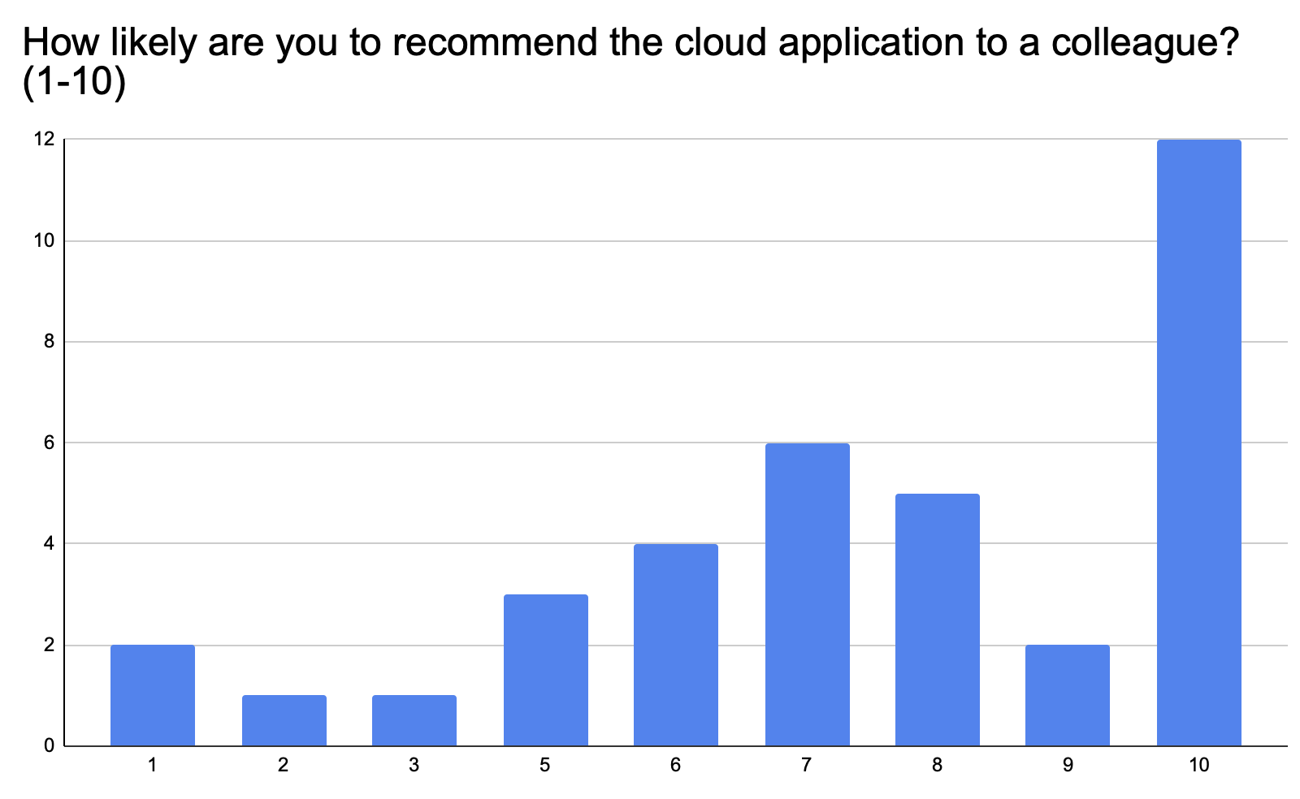
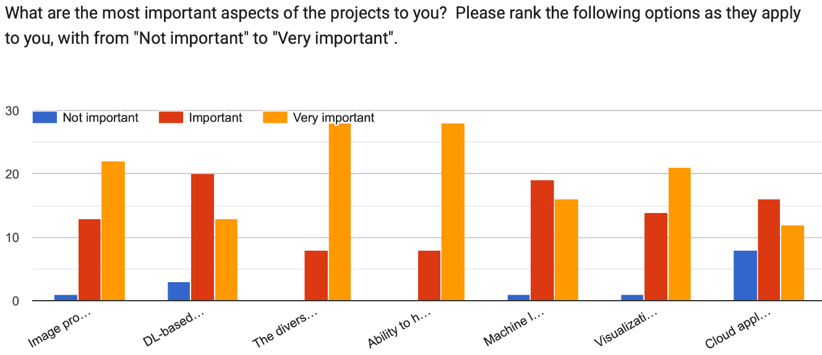
Milestones for Year 1
1.5 Conduct outreach activities including user feedback
-- Have developed a web site, including an easy to fill online survey: neuroimaginchart.com
-- Sent multiple tweets, which have collectively received over 20,000 reads and numerous reactions
-- Have received 37 surveys
-- Have conducted 6 interviews, planned 7 more
-- Respondents found the concept & usage of NiChart clear.
-- Users who tested the application reported a smooth experience and satisfactory results
-- High likelihood of recommending the application to colleagues, with scores frequently at or above 8 out of 10.
-- Significant portion of users willing to provide detailed feedback.

Slide 14
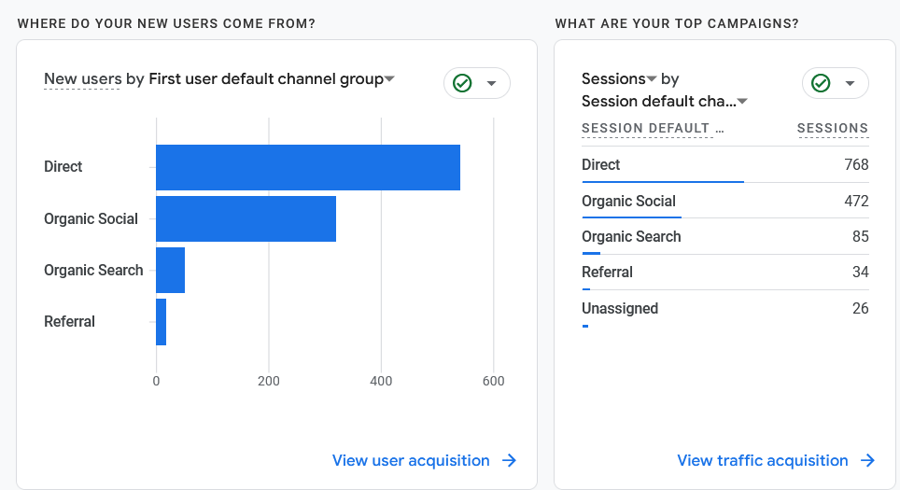
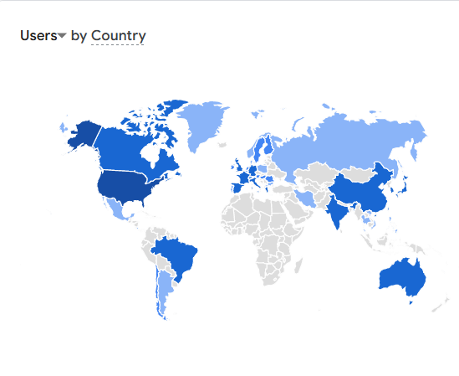
Milestones for Year 1
1.6 Start Distribution of containerized technology via Dockerhub
-- Containerized pipelines are distributed in github, Dockerhub
-- Specific models for pipelines can be found as downloadable files in packages’ distributions
-- Web portal and sMRI pipeline already accessible under neuroimaginchart.com/portal
-- Registered users: 43
-- Active users: 19
-- Total submitted jobs: 757
-- Total website views: 6,100
-- Page interaction: 10,000

Slide 15
Milestones for Year 2
2.1 Hold two Scientific Steering Group (SSG) meetings
2.2 Software optimization
-- ”Translation” between Freesurfer and MUSE values using neural networks → ML models derived from MUSE applied to FS ROIs. FEEDBACK?
-- Additional ML models (cardiometabolic risk factors; brain aging trajectories)
-- Light front-end of NiChart for data exploration and visualization (Guray; demo)
-- Process 4,000 rsfMRI scans → determine normative range for functional network components
2.3 Conduct outreach activities including user feedback
FEEDBACK?
2.4 Disseminate technology
--Installed at 10 collaborating institutions
--Obtained feedback
FEEDBACK? Web/Cloud accessibility vs. Standalone use

